Slide 1


ABC
CALL VOLUME TREND
Presented by,
Manu Moolimani

Slide 2




PROJECT DESCRIPTION
This project focuses on Customer Experience (CX) analytics for the inbound calling team of ABC Company. The aim is to analyze a dataset spanning 23 days, covering various aspects such as agent details, queue time, call duration, and call status. The objective is to derive insights that will assist in optimizing manpower allocation, reducing call abandon rates, and improving overall customer satisfaction.
This analysis is critical for enhancing customer experience and ensuring that the company's resources are utilized efficiently, particularly in managing the high volume of inbound calls.
TECH-STACK
Microsoft Excel: Used for data cleaning, analysis, pivot tables, and creating visualizations.

Slide 3

APPROACH
In this project, I focused on analyzing the inbound call data of ABC Insurance to enhance customer experience and optimize resource allocation. The first step was data cleaning, which involved handling missing values and ensuring consistency in time-related data. This was crucial to ensure accurate and reliable analysis, and performed different tasks.
Tasks
Task 1: Average Call Duration - Calculated the average duration of calls for each time bucket.
Task 2: Call Volume Analysis - Visualized the total number of calls received in each time bucket.
Task 3: Manpower Planning - Proposed a manpower allocation plan to reduce the call abandon rate from 30% to 10%.
Task 4: Night Shift Manpower Planning - Estimated the night call volume and proposed a plan to ensure a 10% abandon rate during night hours.

Slide 4
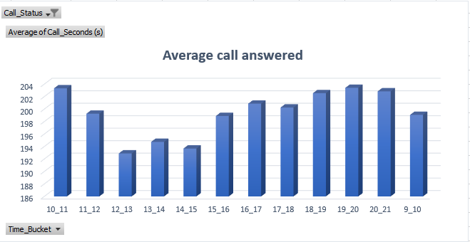
INSIGHTS
AVERAGE CALL DURATION
Certain time buckets had significantly longer average call durations, suggesting that more complex issues are being addressed during these times. This insight can help in training and agent assignment.
The Average call duration answered by an agent is 198 seconds.
The peek hours are 10am-11am and 7pm-8pm and the minimum call duration is at 12pm-1pm.

Slide 5
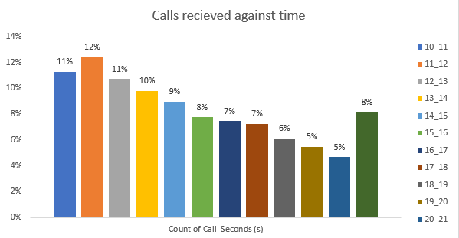
INSIGHTS
CALL VOLUME ANALYSIS
The analysis revealed specific time buckets with high call volumes, particularly during mid-morning and late evening. This information is critical for ensuring sufficient agent coverage during these periods. The analysis presents the peek and off-peek time buckets.
The Highest number of calls received is between 11am-12pm.
The least number of calls received is between 8pm-9pm.

Slide 6
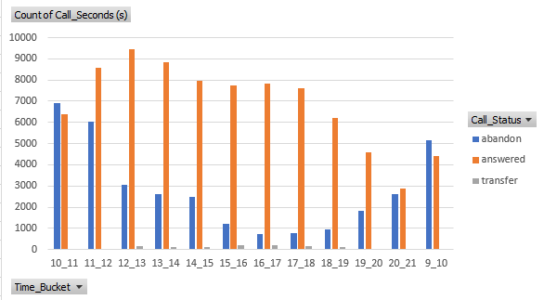

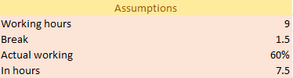
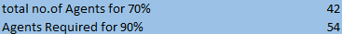
INSIGHTS
MAN POWER PLANNING
The analysis identified the need for increased staffing during peak hours to reduce the current high abandon rate, which is crucial for improving customer satisfaction.
Almost 30% of the calls are getting abandoned.
Based on these assumptions the Actual work hours of per agents is 4.5 hrs.
The no. of agents that answered the calls was 70% i.e. 42.
The total no. of agents required to reduce the abandoned rate to 10% is 54 i.e. 12 more persons.

Slide 7
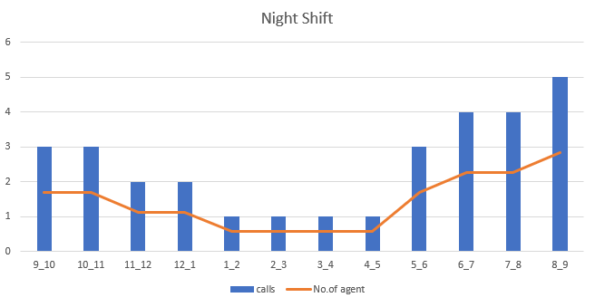
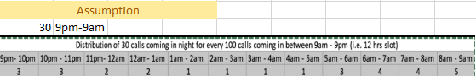
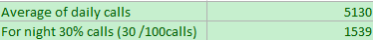
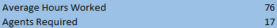
INSIGHTS
NIGHT SHIFT MANPOWER
The lack of night shift coverage was highlighted as a significant gap in service, necessitating the introduction of a night shift team to handle the estimated call volume effectively.
Assuming 30 calls at night for every 100 calls, it is 30% of calls.
The average incoming calls is 5130 and 30% of the average is 1539 incoming calls at night.
The Average hours worked at night is 76 by calculating =30% of calls*average call seconds*90%/3600 seconds.
The no. of agents required were 17 for night shifts.

Slide 8


Results
The analysis provided actionable insights for optimizing ABC Insurance's inbound calling team operations. By strategically allocating agents based on call volume and time of day, the company can significantly reduce the call abandon rate and improve overall customer satisfaction. Additionally, the proposed introduction of night shift coverage addresses a critical gap in the service, ensuring that customers receive timely assistance even outside of standard business hours.
The results of this analysis will support data-driven decisions in manpower planning, training, and operational improvements, ultimately leading to enhanced customer experience and increased efficiency for the company.
Excel Results
manumoolimani7@gmail.com

